Slide 1
Python Variables and Data Types

Slide 2
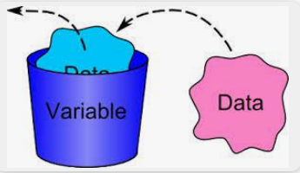
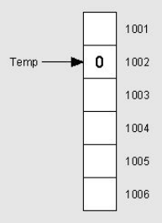
Variables?
A variable is a container for a value. It can be assigned a name.
Notes:
Variable is a named container

Slide 3
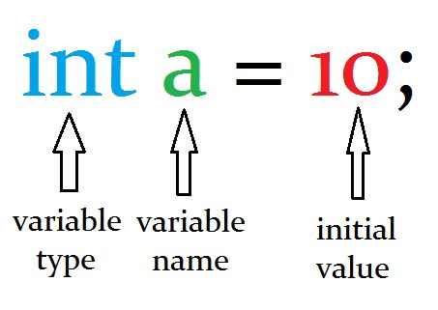
What are ‘C’ Variables?

Slide 4
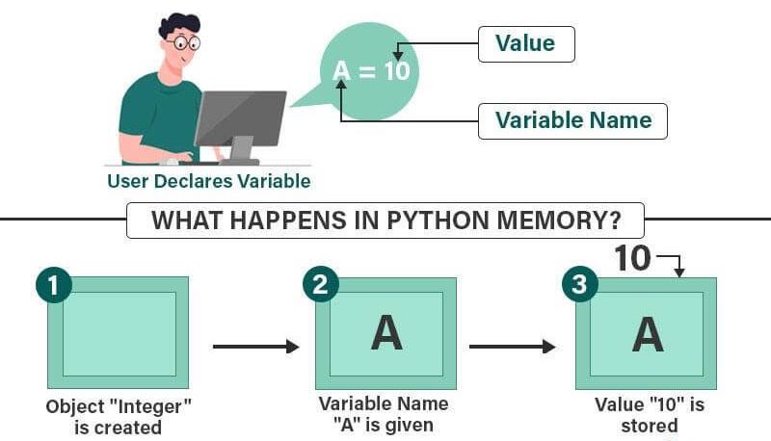
Python Variables
Python Variables are memory spaces that hold information, such as numbers or text, that the Python Code can later use to perform tasks.

Slide 5
Rules for naming variables
The variable name should start with an underscore or letter.
Example: _educba, xyz, ABC
2. Using a number at the start of a variable name is not allowed.
Examples of incorrect variable names: 1variable, 23alpha, 390say
3. The variable name can only include alphanumeric characters and underscore.
Example: learn_python, c4, C564_85
4. Variable names in Python are case-sensitive.
Examples of different variable names: python, Python, PYTHON
5. Reserved words in Python cannot be a variable name.
Example: while, if, print, while

Slide 6
Python Data Types
Data types are the classification or categorization of data items.
It represents the kind of value that tells what operations can be performed on a particular data.
Since everything is an object in Python programming, data types are actually classes and variables are instances (object) of these classes.
Notes:
a data type is a collection or grouping of data values, usually specified by a set of possible values, a set of allowed operations on these values, and/or a representation of these values as machine types.

Slide 7
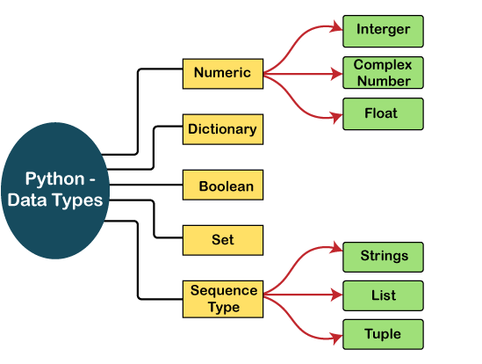

Slide 8
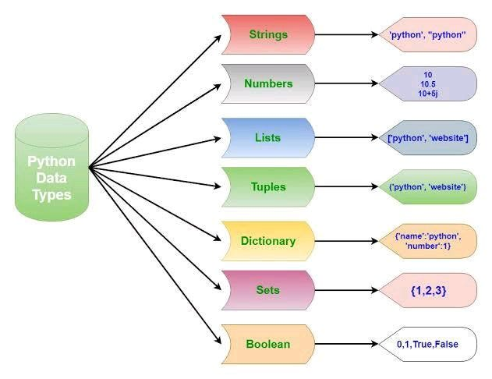
Variable data types, show the type of data stored in the variable.

Slide 9
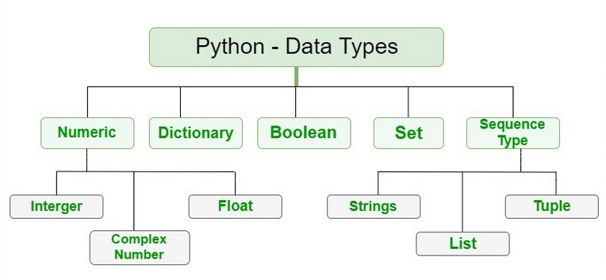
Numeric Data Type in Python

Slide 10
Numeric Data Type in Python
The numeric data type in Python represents the data that has a numeric value. A numeric value can be an integer, a floating number, or even a complex number. These values are defined as Python int, Python float, and Python complex classes in Python.
Integers – This value is represented by int class. It contains positive or negative whole numbers (without fractions or decimals). In Python, there is no limit to how long an integer value can be.
Float – This value is represented by the float class. It is a real number with a floating-point representation. It is specified by a decimal point. Optionally, the character e or E followed by a positive or negative integer may be appended to specify scientific notation.
Complex Numbers – Complex number is represented by a complex class. It is specified as (real part) + (imaginary part)j. For example – 2+3j

Slide 11
Determine the type of data type.
type() function
# Python program to
# demonstrate numeric value
a = 5
print("Type of a: ", type(a))
b = 5.0
print(“ \nType of b: ", type(b))
c = 2 + 4j
print(“ \nType of c: ", type(c))

Slide 12
Sequence Data Type in Python

Slide 13
Sequence Data Type in Python
The sequence Data Type in Python is the ordered collection of similar or different data types.
Sequences allow storing of multiple values in an organized and efficient fashion.
Sequence types in Python –
Python String
Python List
Python Tuple

Slide 14
String Data Type
Strings in Python are arrays of bytes representing
Unicode characters.
A string is a collection of one or more characters
put in a single quote, double-quote, or triple-quote.
In python there is no character data type
A character is a string of length one.
It is represented by str class.
Creating String
Single quotes or double quotes or even triple quotes.

Slide 15
String Data Type
Strings in Python are arrays of bytes representing Unicode characters.
A string is a collection of one or more characters
put in a single quote, double-quote, or triple-quote.
In python there is no character data type
A character is a string of length one.
It is represented by str class.
Creating String
Single quotes or double quotes or even triple quotes.
String1 = 'python primer'
String2 = "I'm from Kerala"
String3 = """I'm living in "Gods" own country"""
print(type(String1))

Slide 16

Accessing elements of String
In Python, individual characters of a String can be accessed by using the method of Indexing.
Negative Indexing allows negative address references to access characters from the back of the String,
e.g. -1 refers to the last character, -2 refers to the second last character, and so on.
# Python Program to Access
# characters of String
String1 = "MICROPYTHON"
print("Initial String: ")
print(String1)
# Printing First character
print("\nFirst character of String is: ")
print(String1[0])
# Printing Last character
print("\nLast character of String is: ")
print(String1[-1])

Slide 17
Sequence Data Type in Python

Slide 18
List Data Type
Lists are just like arrays, declared in other languages which is an ordered collection of data.
It is very flexible as the items in a list do not need to be of the same type.
Creating List
Lists in Python can be created by just placing the sequence inside the square brackets[].

Slide 19
Usage of List Data Type
# Creating a List
List = []
print("Initial blank List: ")
print(List)
# Creating a List with the use of a String
List = ['MicroPython']
print("\n List with the use of String: ")
print(List)
# Creating a List with the use of multiple values
List = ["Micro", "Python", "Primer"]
print("\n List containing multiple values: ")
print(List[0])
print(List[2])
print(List[-2])

Slide 20
Sequence Data Type in Python

Slide 21
Tuple Data Type
Just like a list, a tuple is also an ordered collection of Python objects.
The only difference between a tuple and a list is that tuples are immutable
i.e. tuples cannot be modified after it is created.
It is represented by a tuple class.
Creating a Tuple
In Python, tuples are created by placing a sequence of values separated by a ‘comma’ with or without the use of parentheses for grouping the data sequence.
Tuples can contain any number of elements and of any datatype (like strings, integers, lists, etc.).
Note: Tuples can also be created with a single element, but it is a bit tricky.
Having one element in the parentheses is not sufficient, there must be a trailing ‘comma’ to make it a tuple.

Slide 22
Usage of Tuple Data Type
# Creating a Tuple with the use of Strings
Tuple1 = ('Micro', 'Python')
print("\nTuple with the use of String: ")
print(Tuple1)
# Creating a Tuple with the use of list
list1 = [1, 2, 4, 5, 6]
print("\nTuple using List: ")
print(tuple(list1))
# Creating a Tuple with the use of built-in function
Tuple1 = tuple('Python')
print("\nTuple with the use of function: ")
print(Tuple1)
# Creating a Tuple with nested tuples
Tuple1 = (0, 1, 2, 3)
Tuple2 = ('Micro', 'Python')
Tuple3 = (Tuple1, Tuple2)
print("\nTuple with nested tuples: ")
print(Tuple3)

Slide 23
Boolean Data Type in Python
Data type with one of the two built-in values, True or False.
boolean objects that are equal to True are truthy (true),
and those equal to False are falsy (false).
Note – True and False with capital ‘T’ and ‘F’
are valid booleans otherwise python will throw an error.
# Python program to
# demonstrate boolean type
print(type(True))
print(type(False))
print(type(true))

Slide 24
Set Data Type in Python
In Python, a Set is an unordered collection of data types that is iterable, mutable and has no duplicate elements.
The order of elements in a set is undefined though it may consist of various elements.
Create a Set in Python
Sets can be created by using the built-in set() function with an iterable object or a sequence by placing the sequence inside curly braces, separated by a ‘comma’.
The type of elements in a set need not be the same, various mixed-up data type values can also be passed to the set.

Slide 25
Usage of List set Type
# Python program to demonstrate
# Creation of Set in Python
# Creating a Set with the use of a String
set1 = set("GeeksForGeeks")
print("\nSet with the use of String: ")
print(set1)
# Creating a Set with the use of a List
set1 = set(["Geeks", "For", "Geeks"])
print("\nSet with the use of List: ")
print(set1)
# Creating a Set with a mixed type of values
# (Having numbers and strings)
set1 = set([1, 2, 'Geeks', 4, 'For', 6, 'Geeks'])
print("\nSet with the use of Mixed Values")
print(set1)

Slide 26
Dictionary Data Type in Python
A dictionary in Python is an unordered collection of data values, used to store data values like a map, unlike other Data Types that hold only a single value as an element, a Dictionary holds a key: value pair. Key-value is provided in the dictionary to make it more optimized.
Each key-value pair in a Dictionary is separated by a colon : , whereas each key is separated by a ‘comma’.
Create a Dictionary
In Python, a Dictionary can be created by placing a sequence of elements within curly {} braces, separated by ‘comma’.
Values in a dictionary can be of any datatype and can be duplicated, whereas keys can’t be repeated and must be immutable.
The dictionary can also be created by the built-in function dict().
An empty dictionary can be created by just placing it in curly braces{}.
Note – Dictionary keys are case sensitive, the same name but different cases of Key will be treated distinctly.

Slide 27
Usage of Dictionary Data Type
# Creating a Dictionary with Integer Keys
Dict = {1: 'Micro', 2: 'For', 3: 'Python'}
print("\nDictionary with the use of Integer Keys: ")
print(Dict)
# Creating a Dictionary with Mixed keys
Dict = {'Name': 'Python', 1: [1, 2, 3, 4]}
print("\nDictionary with the use of Mixed Keys: ")
print(Dict)
# Creating a Dictionary with dict() method
Dict = dict({1: 'Micro', 2: 'Python', 3: 'Primer'})
print("\nDictionary with the use of dict(): ")
print(Dict)
# Creating a Dictionary with each item as a Pair
Dict = dict([(1, 'Micro'), (2, 'Python')])
print("\nDictionary with each item as a pair: ")
print(Dict)

Slide 28
Python Booleans
Booleans represent one of two values: True or False.

Slide 29
Dictionary
Dictionaries are used to store data values in key:value pairs.
A dictionary is a collection which is ordered
Changeable and
Do not allow duplicates.

Slide 30
Set
Sets are used to store multiple items in a single variable.
A set is a collection which is unordered, unchangeable, and unindexed.

